Slide 1

Section 1
Babbacombe Bay Café
description and evaluation
https://babbacombebaycafe.co.uk/
Notes:
Babbacombe Bay Café’s website aims to attract customers by providing essential information like menus, location, opening hours and booking options.

Slide 2





Babbacombe Bay Café Website
Menus
Location
Opening hours
Booking
Notes:
Babbacombe Bay Café’s is a website aiming to attract customers to the café and provide them with essential information
Such as menus,
location,
opening hours
and booking options.

Slide 3
User Goals - All
Find location
Check its dog friendly
View menu
Find contact information
View prices
Find outside catering information
Dietary requirements
View about us of café
View images
View customer reviews
Check times for set menus
View social media updates
Check opening hours
Find social media links
Find voucher information
Book a table
Notes:
To evaluate the website I found 16 user goals from across all pages

Slide 4

User Goals – Common
Find location
Check its dog friendly
View menu
Find contact information
View prices
Find outside catering information
Primary
Secondary
Dietary requirements
View about us of café
View images
View customer reviews
Check times for set menus
View social media updates
Check opening hours
Find social media links
Find voucher information
Book a table
Notes:
Which I categorised into primary goals and secondary goals.
The primary goals are the most important as these are the common goals the user will be trying to achieve

Slide 5

Task Scenarios - Creation
Who:
Is performing the task?
What:
Are they trying to achieve?
Where:
On the website?
When:
Would they do this?
Why:
Is it important?
How:
Would they complete it?
Notes:
I considered these questions
Who
What
Where
When
Why
And How.
To create test scenarios which mimic real user behaviour

Slide 6
Task Scenarios
Finding Basic Information
Check Opening Hours: You want to visit the café this Saturday for breakfast. Find the opening hours for Saturdays.
Locate Contact Details: You need to book a table for 4 people tomorrow evening. Find the phone number or email to contact the café.
Find the Location: You are going to the café for the first time. Locate the address or map showing its location.
Exploring the menu
Finding the Menu: You are planning to visit the café and want to check if they offer vegan desserts. Find the menu and identify if vegan options are available.
Finding Prices: You are planning to have afternoon tea at the café and want to know the cost of a high tea. Find the menu and locate the price for the high tea.
Identify Dietary Info: You are lactose intolerant and can’t have dairy. Check if there are dairy free options available.
Booking a Table
Book a Table: You want to reserve a table for two this Friday at 7PM. Use the website to make a booking.
General
Navigate to Social Media: You want to see other peoples reviews of the cafe’s dishes. Find and open their Instagram or Facebook page.
Explore Special Offers: Your friend’s birthday is approaching and you heard that the café offers vouchers which you can gift. Find out information about the voucher and how you can order one.
Notes:
The goal being to use the scenarios to help identify problem areas in the café’s website
I then conducted a mock evaluation with peers using these scenarios.
Asking questions about how they found the experience and taking notes of any reactions, hesitation or struggles during.

Slide 7

Mock Evaluation
User Goals
Task Scenarios
Mock Evaluation
Survey Creation
Notes:
And used the findings to shape the main survey.
For example
The mock highlighted that some users struggled to get an immediate idea of the cafes location due to the map being too zoomed out.
So I added a question to the survey regarding the map and how the users felt about its usefulness.

Slide 8
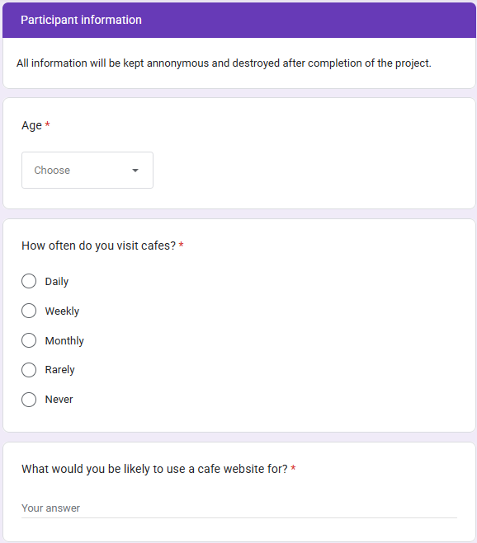
Survey – Participant Information
https://forms.gle/BxnRmUGZQSa1D5Zo8
Notes:
Here are the survey questions which I will quickly show.
So pause if you would like to read them.

Slide 9
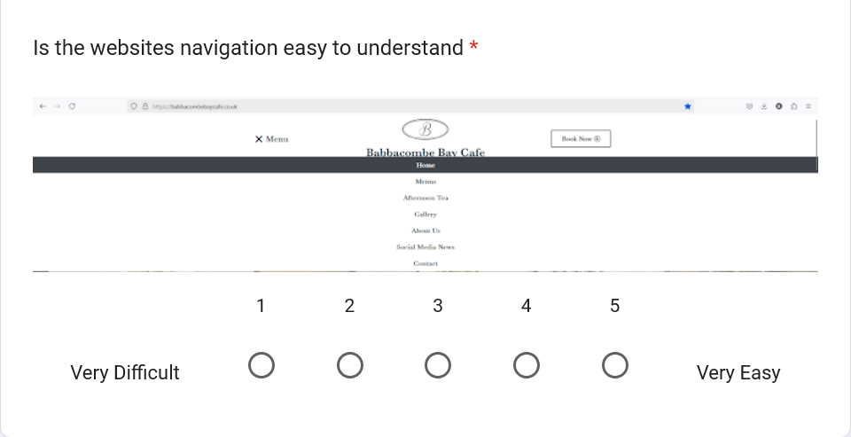
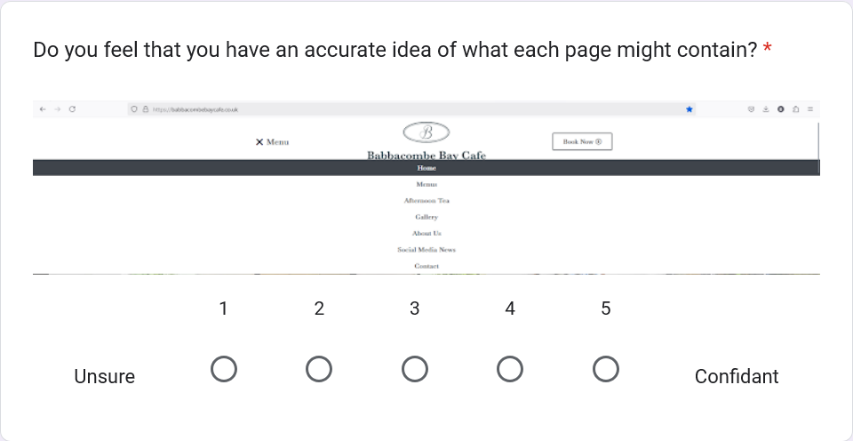
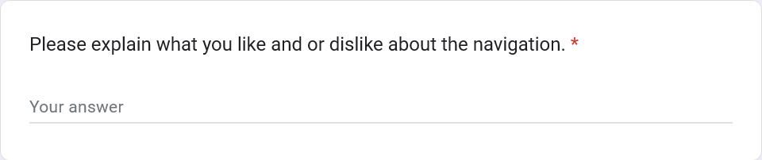
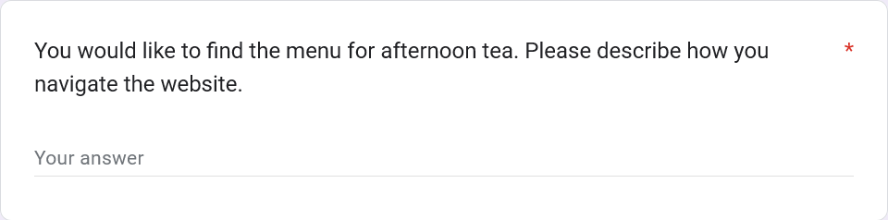
Survey - Navigation
1.
3.
4.
2.

Slide 10
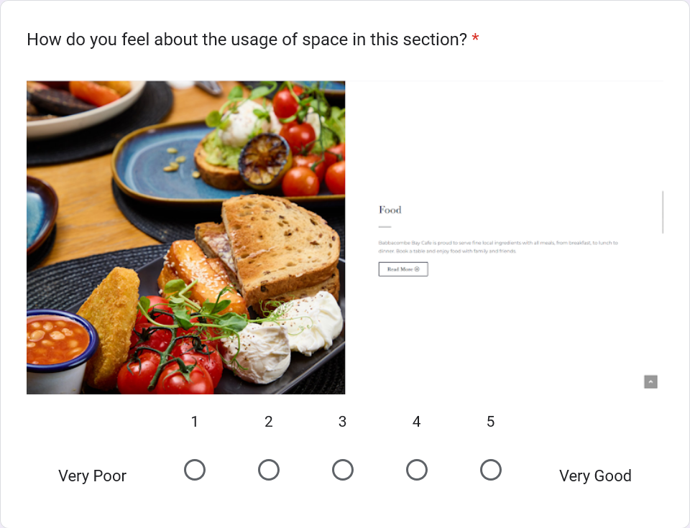
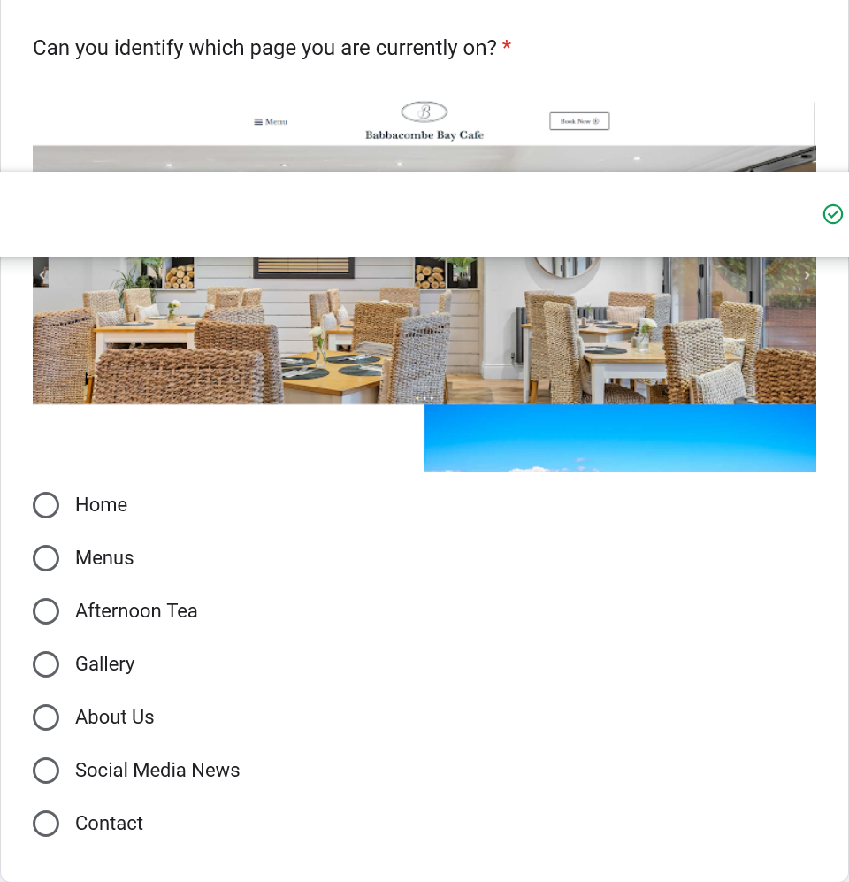
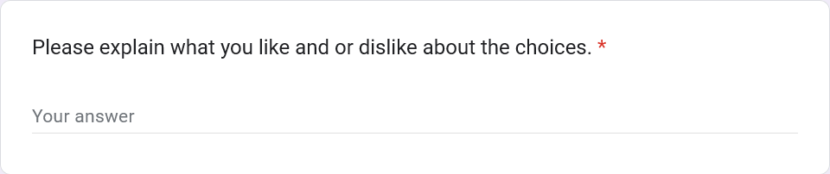
Survey - Pages
4.
5.
6.

Slide 11
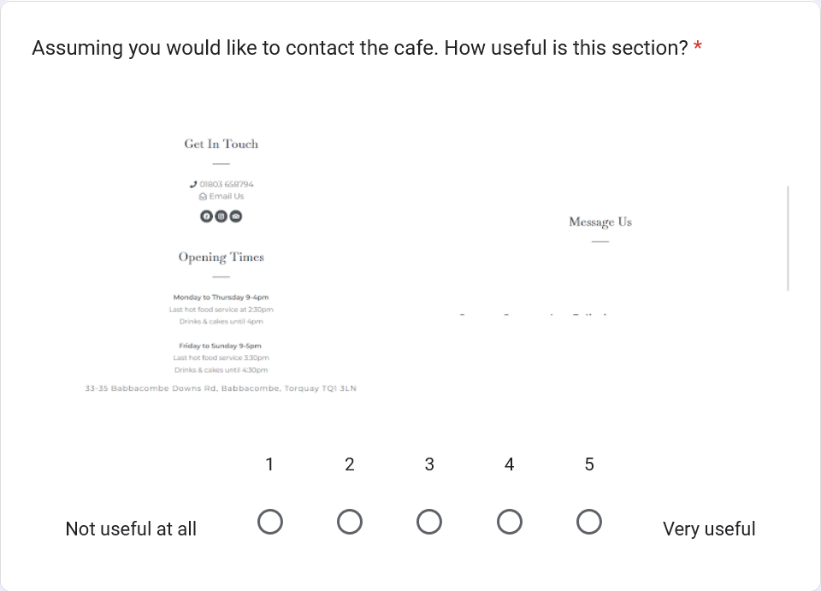
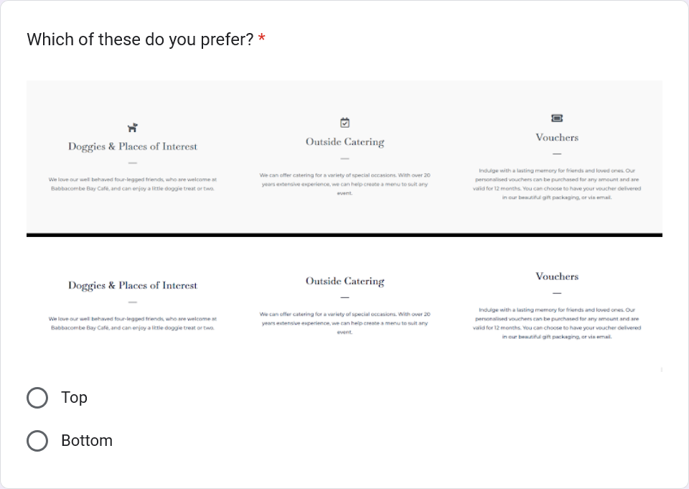
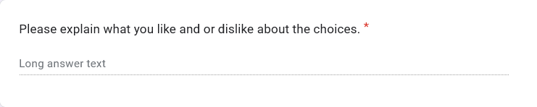
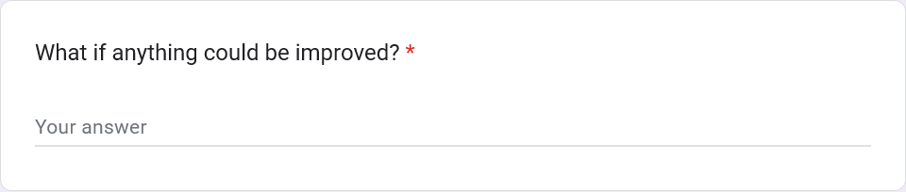
Survey - Pages
9.
7.
10.
8.

Slide 12
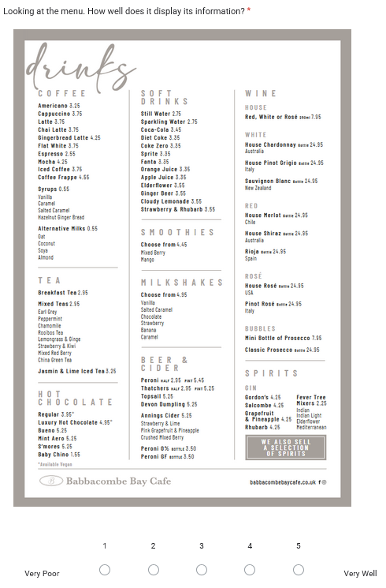
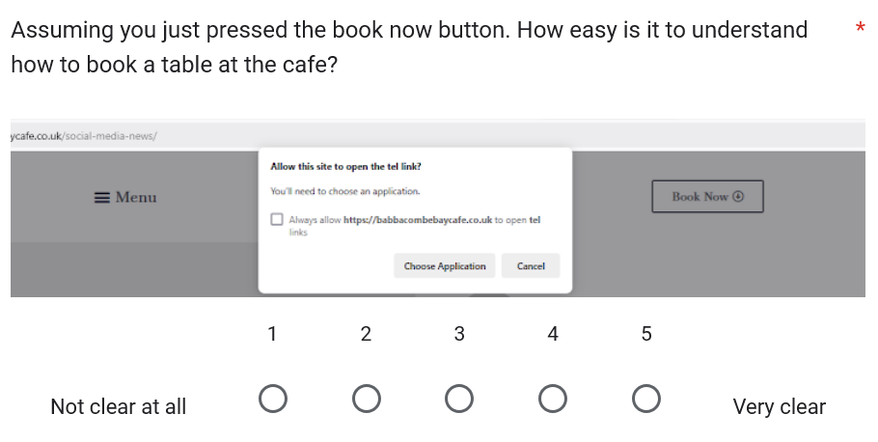
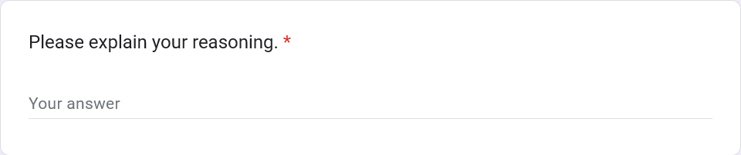
Survey - Pages
13.
11.
12.

Slide 13
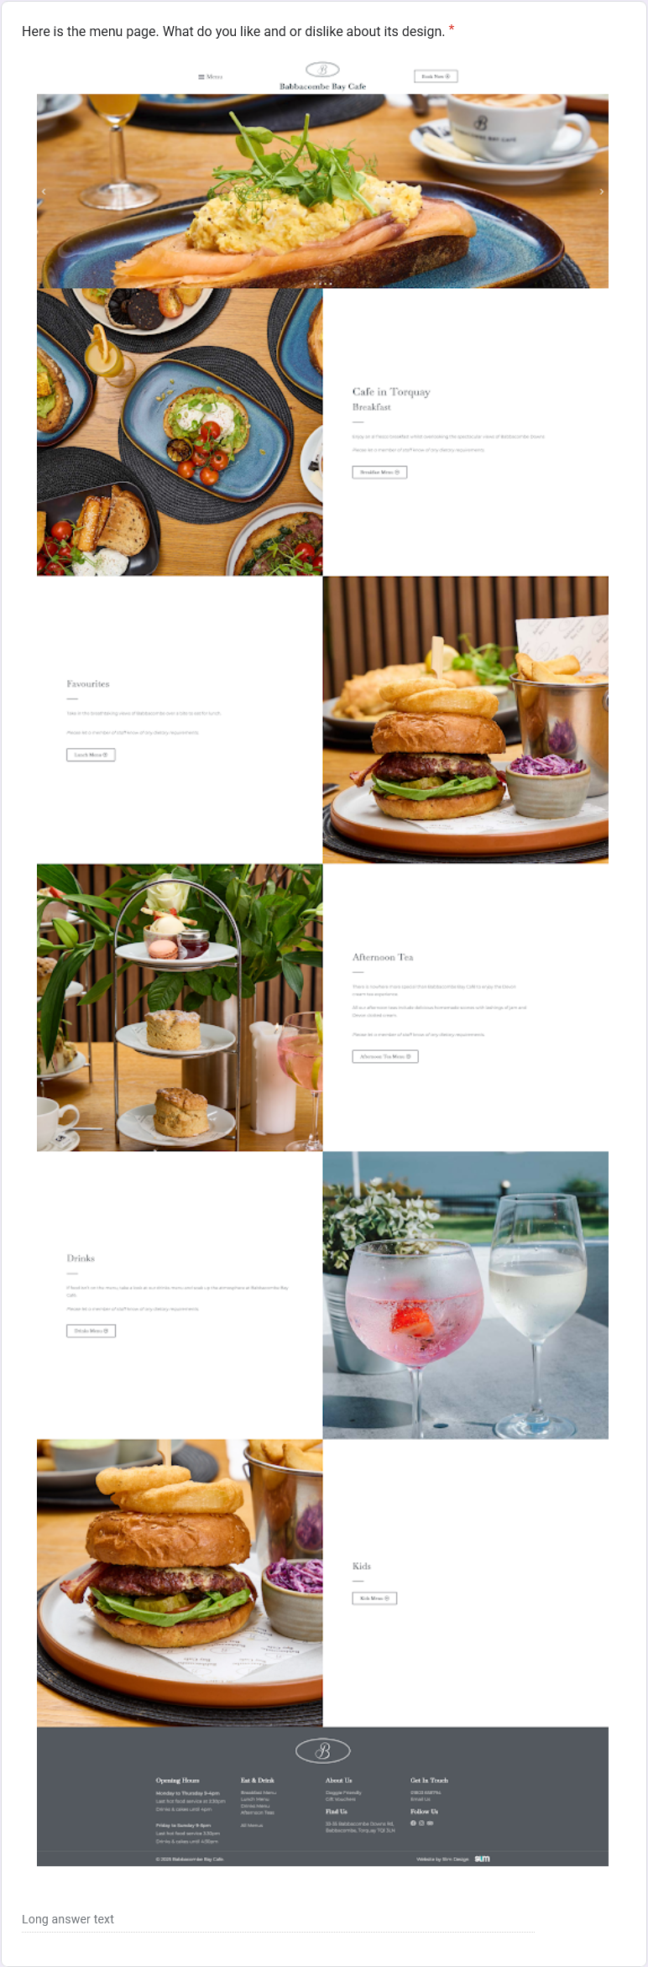
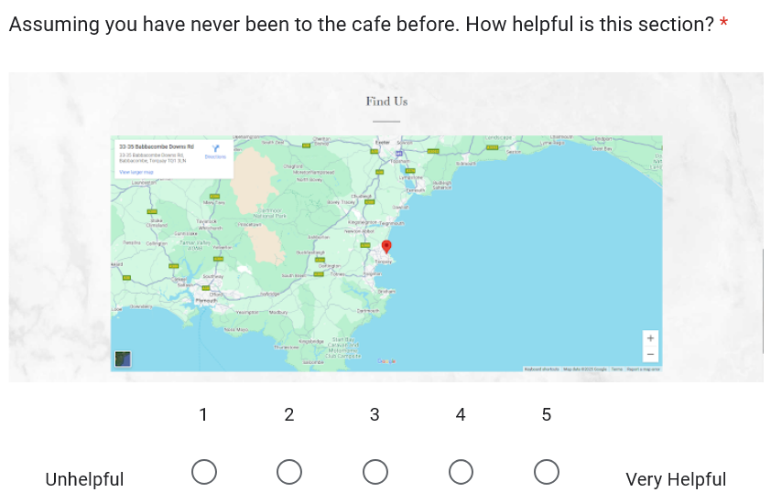
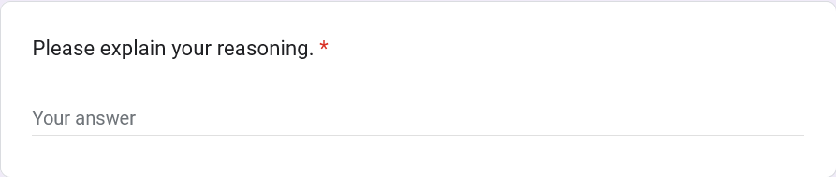
Survey - Pages
16.
14.
15.

Slide 14
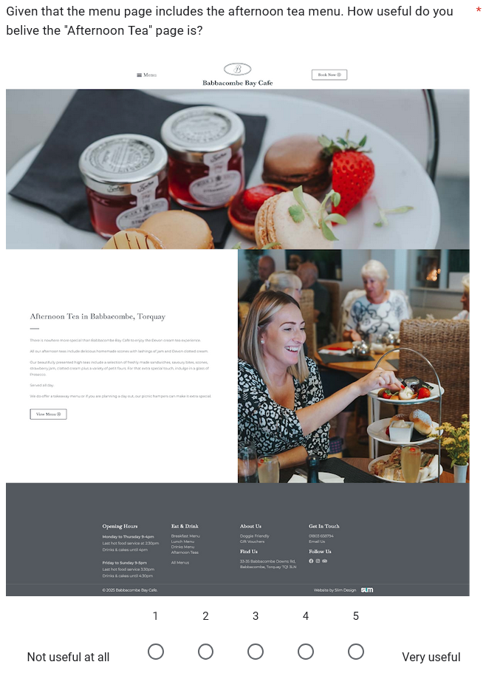
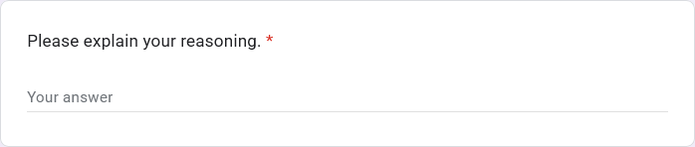
Survey - Pages
17.
18.

Slide 15
Participants
Anonymous Responses
Anonymous feedback encouraged honesty
11 Participants
Café Visit Frequency
8 aged 18-25
1 aged 25-35
1 aged 55-65
4 rarely visit cafés
3 visit monthly
4 visit weekly
Computer Literacy
Potential Bias
All participants were tech proficient
Allowing for detailed and informed feedback
Dominance of 18-25 age range
Tech proficient feedback doesn’t reflect average user
Notes:
All feedback from the survey was anonymous,
With all of the participants being proficient in technology
Which is good for gathering informed feedback however it could potentially introduce biases

Slide 16
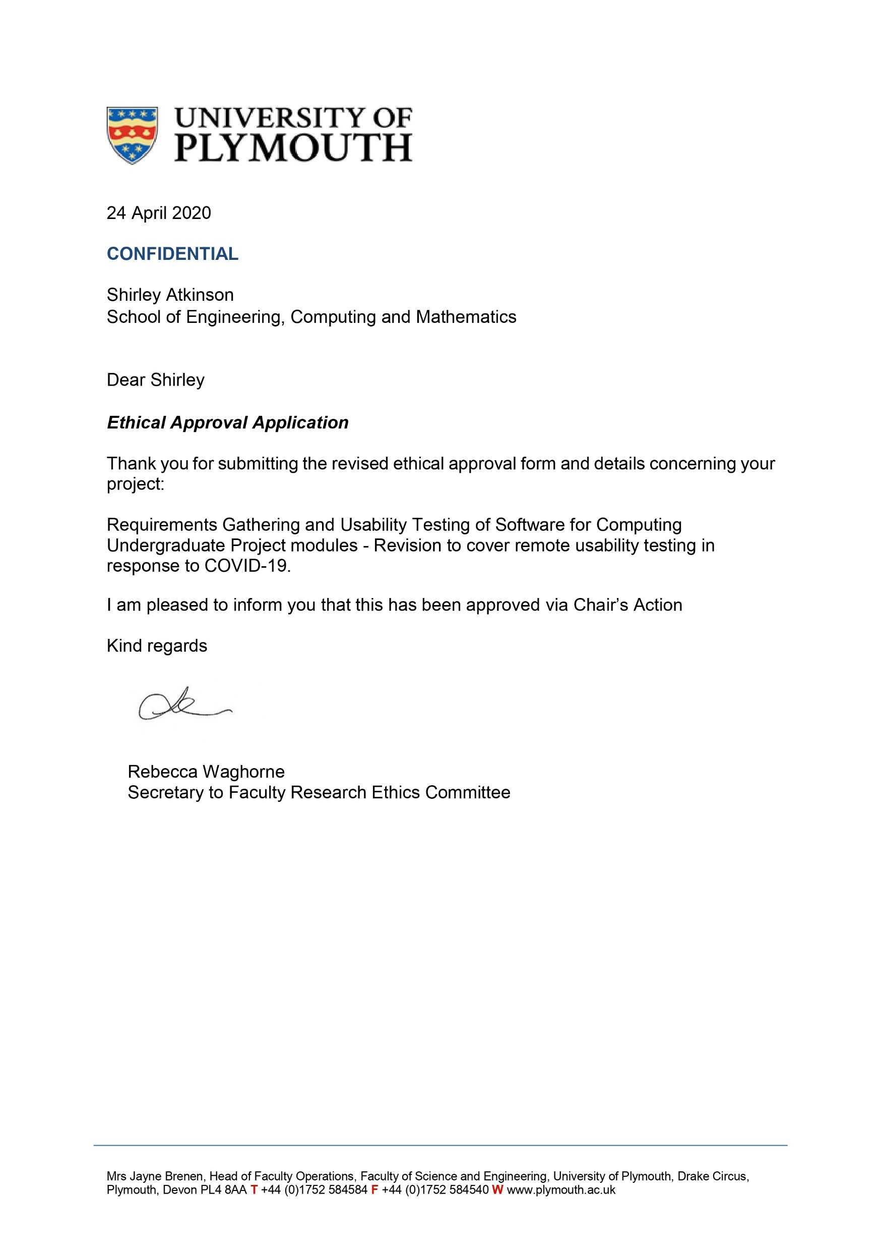
Documentation
University of Plymouth Ethics Approval
Research Information sheet
Right to Withdraw
Ethics Consent Form
Task Scenarios
Exit questionnaire
Notes:
Now onto the documentation.
Please pause to read.

Slide 17
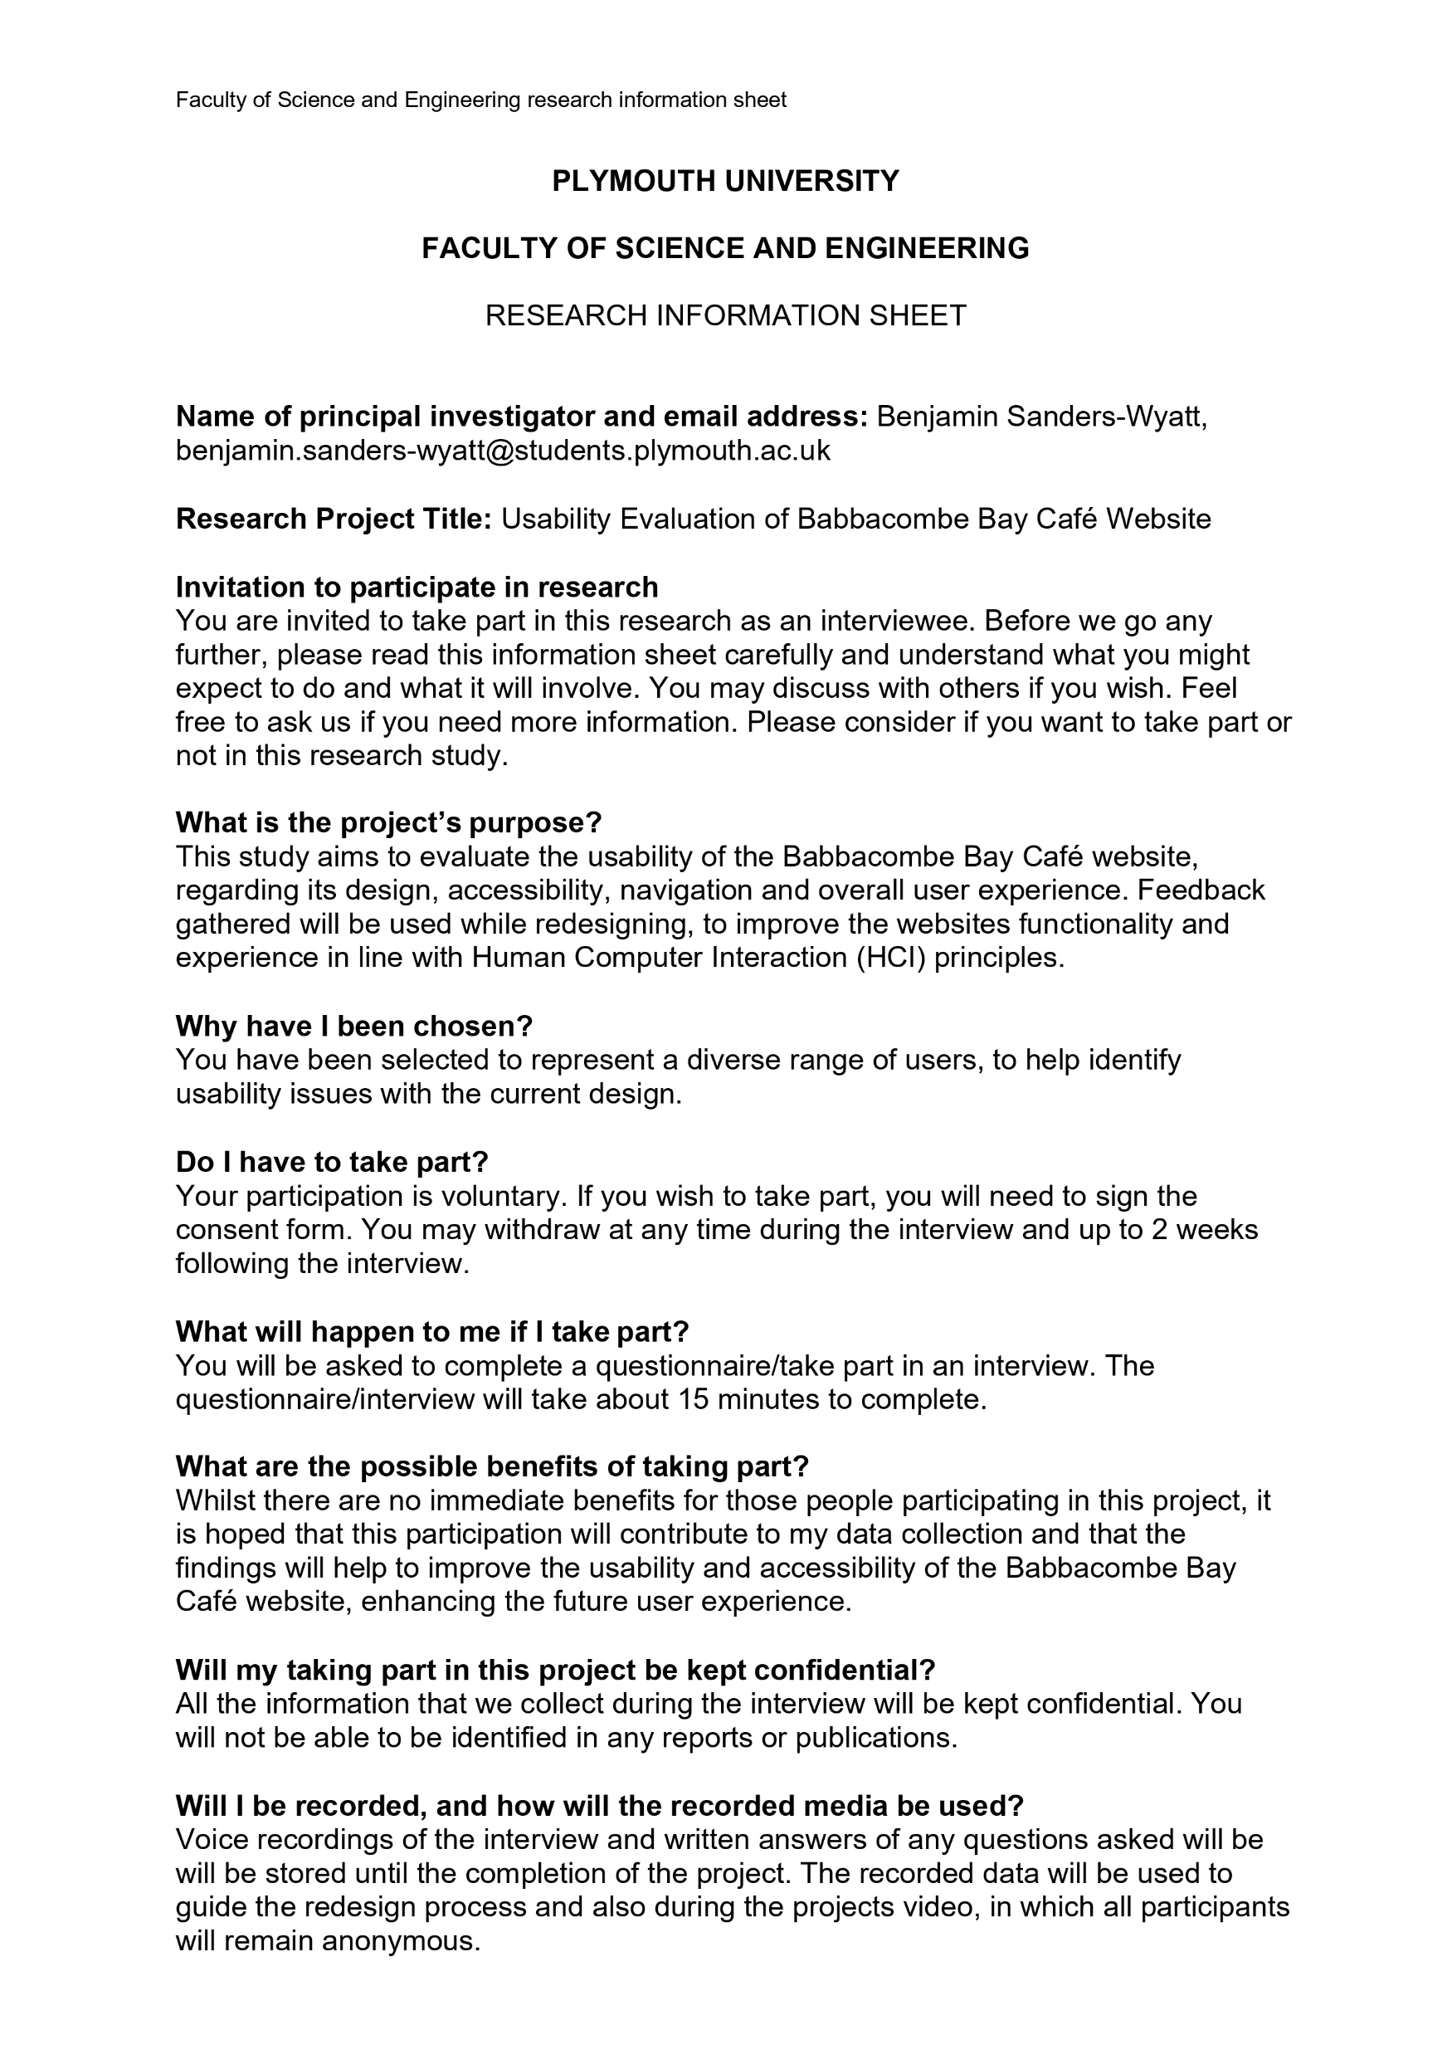
Documentation
University of Plymouth Ethics Approval
Research Information sheet
Right to Withdraw
Ethics Consent Form
Task Scenarios
Exit questionnaire

Slide 18

Documentation
University of Plymouth Ethics Approval
Research Information sheet
Right to Withdraw
Ethics Consent Form
Task Scenarios
Exit questionnaire

Slide 19
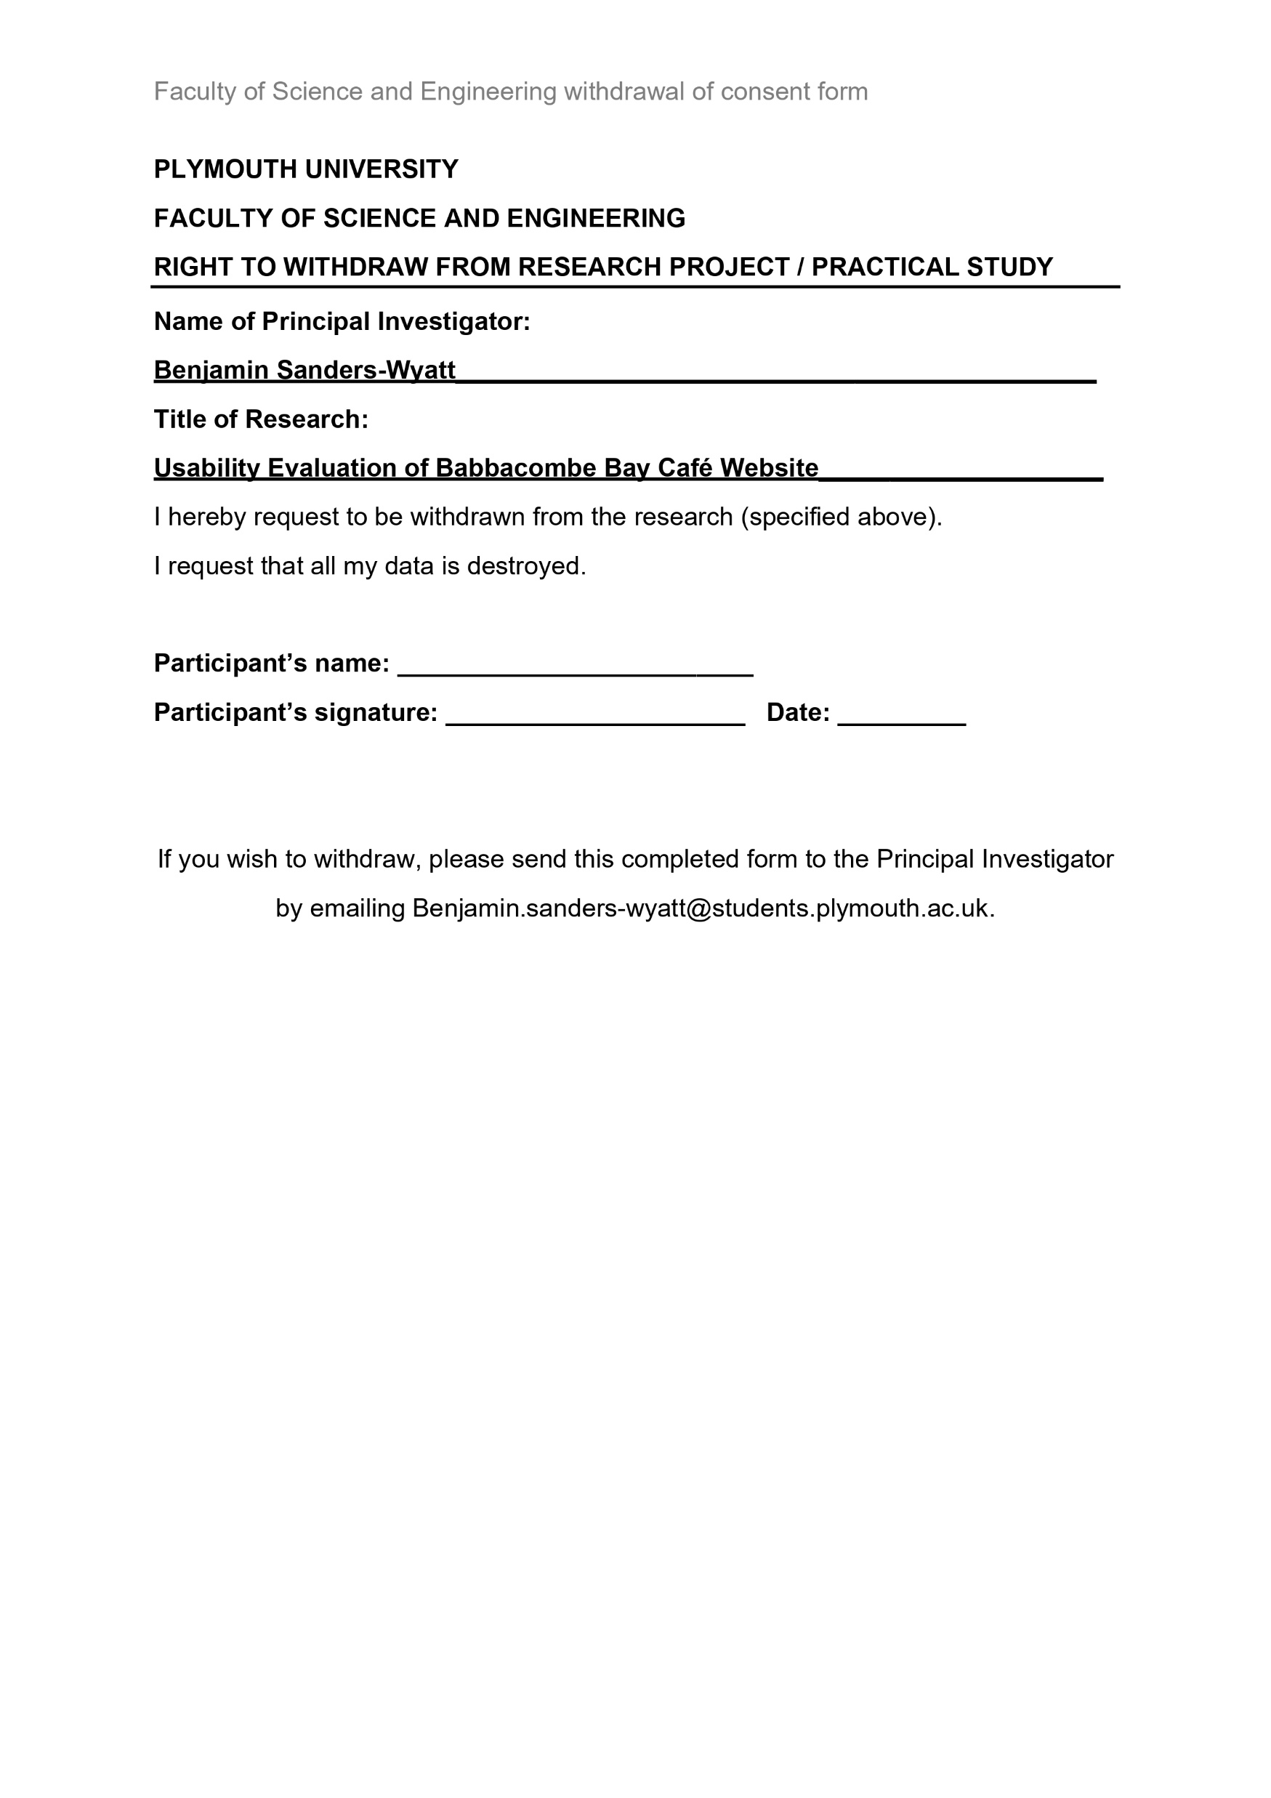
Documentation
University of Plymouth Ethics Approval
Research Information sheet
Right to Withdraw
Ethics Consent Form
Task Scenarios
Exit questionnaire

Slide 20
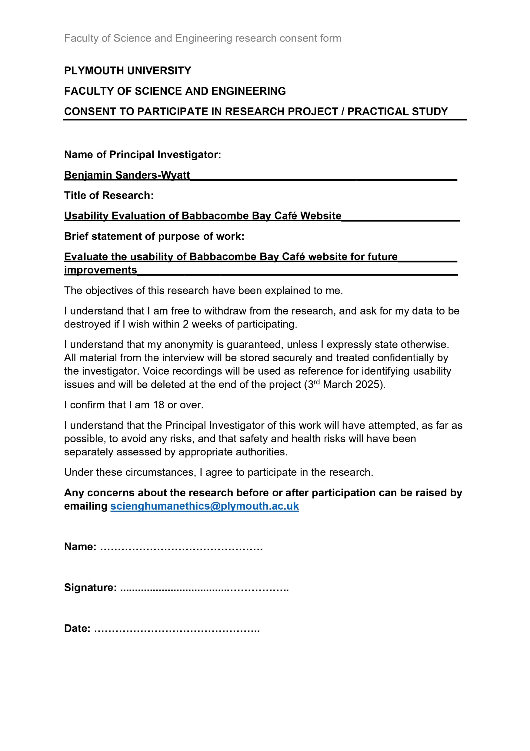
Documentation
University of Plymouth Ethics Approval
Research Information sheet
Right to Withdraw
Ethics Consent Form
Task Scenarios
Exit questionnaire

Slide 21
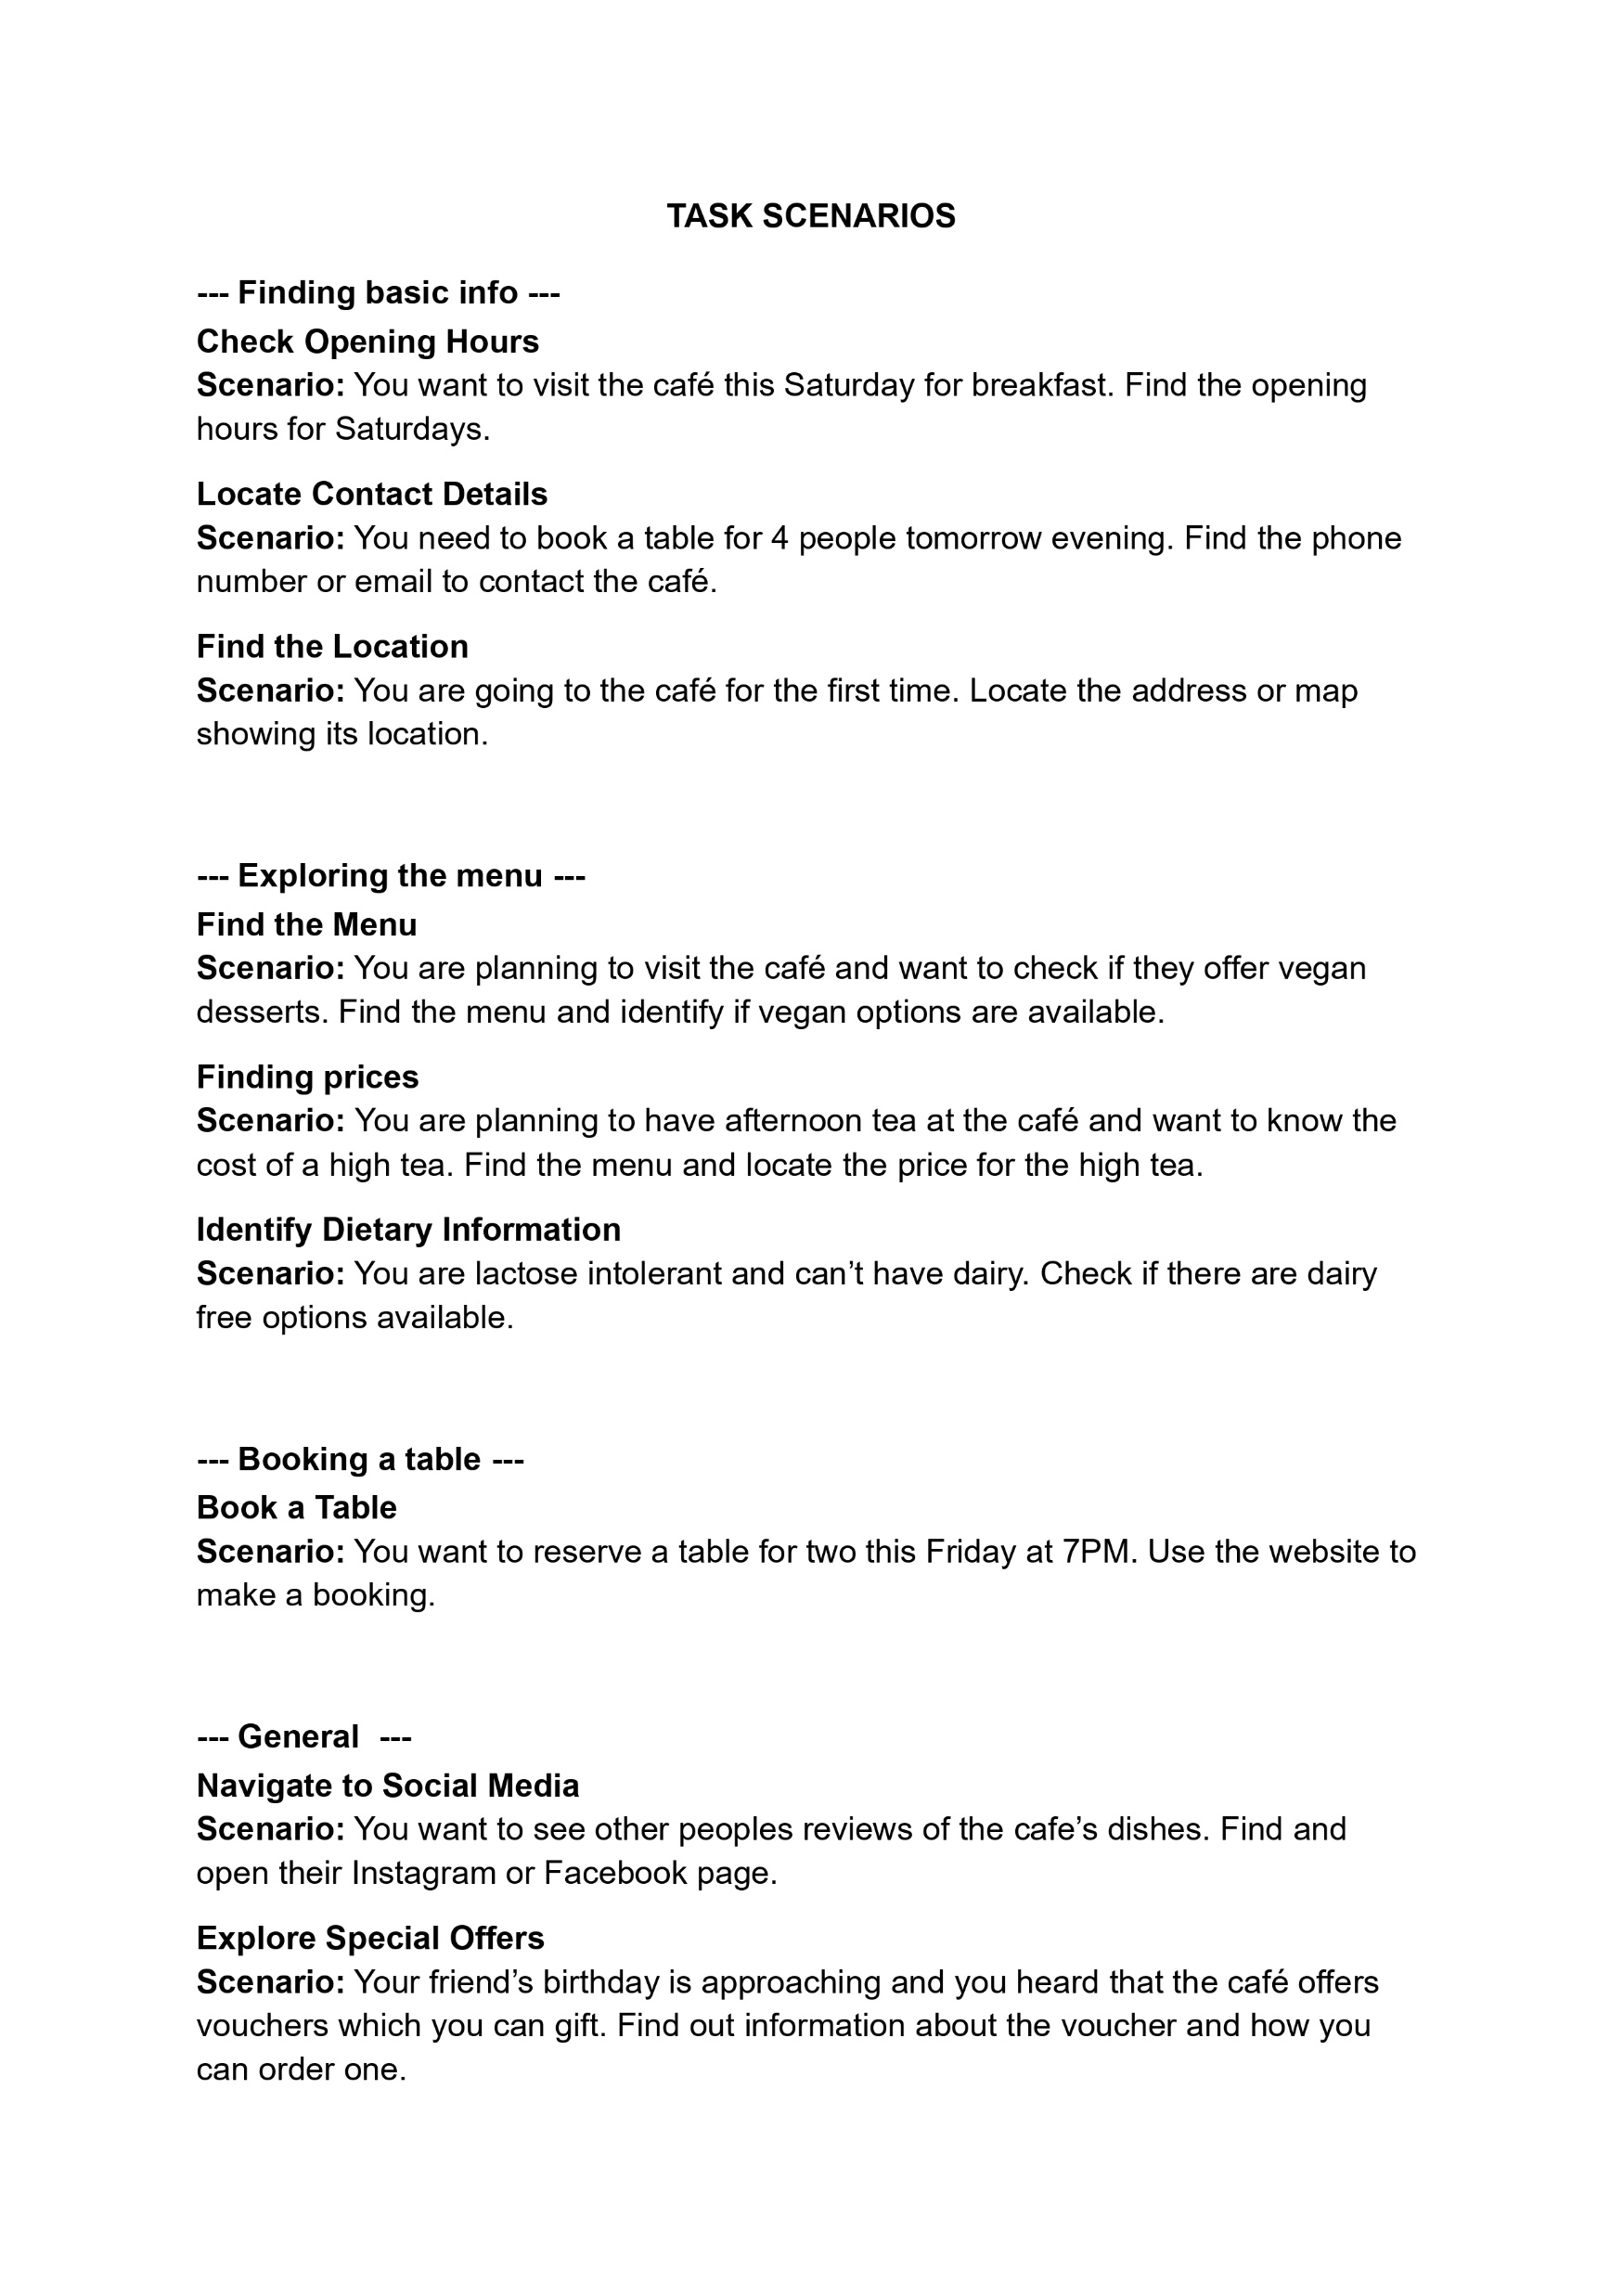
Documentation
University of Plymouth Ethics Approval
Research Information sheet
Right to Withdraw
Ethics Consent Form
Task Scenarios
Exit questionnaire

Slide 22
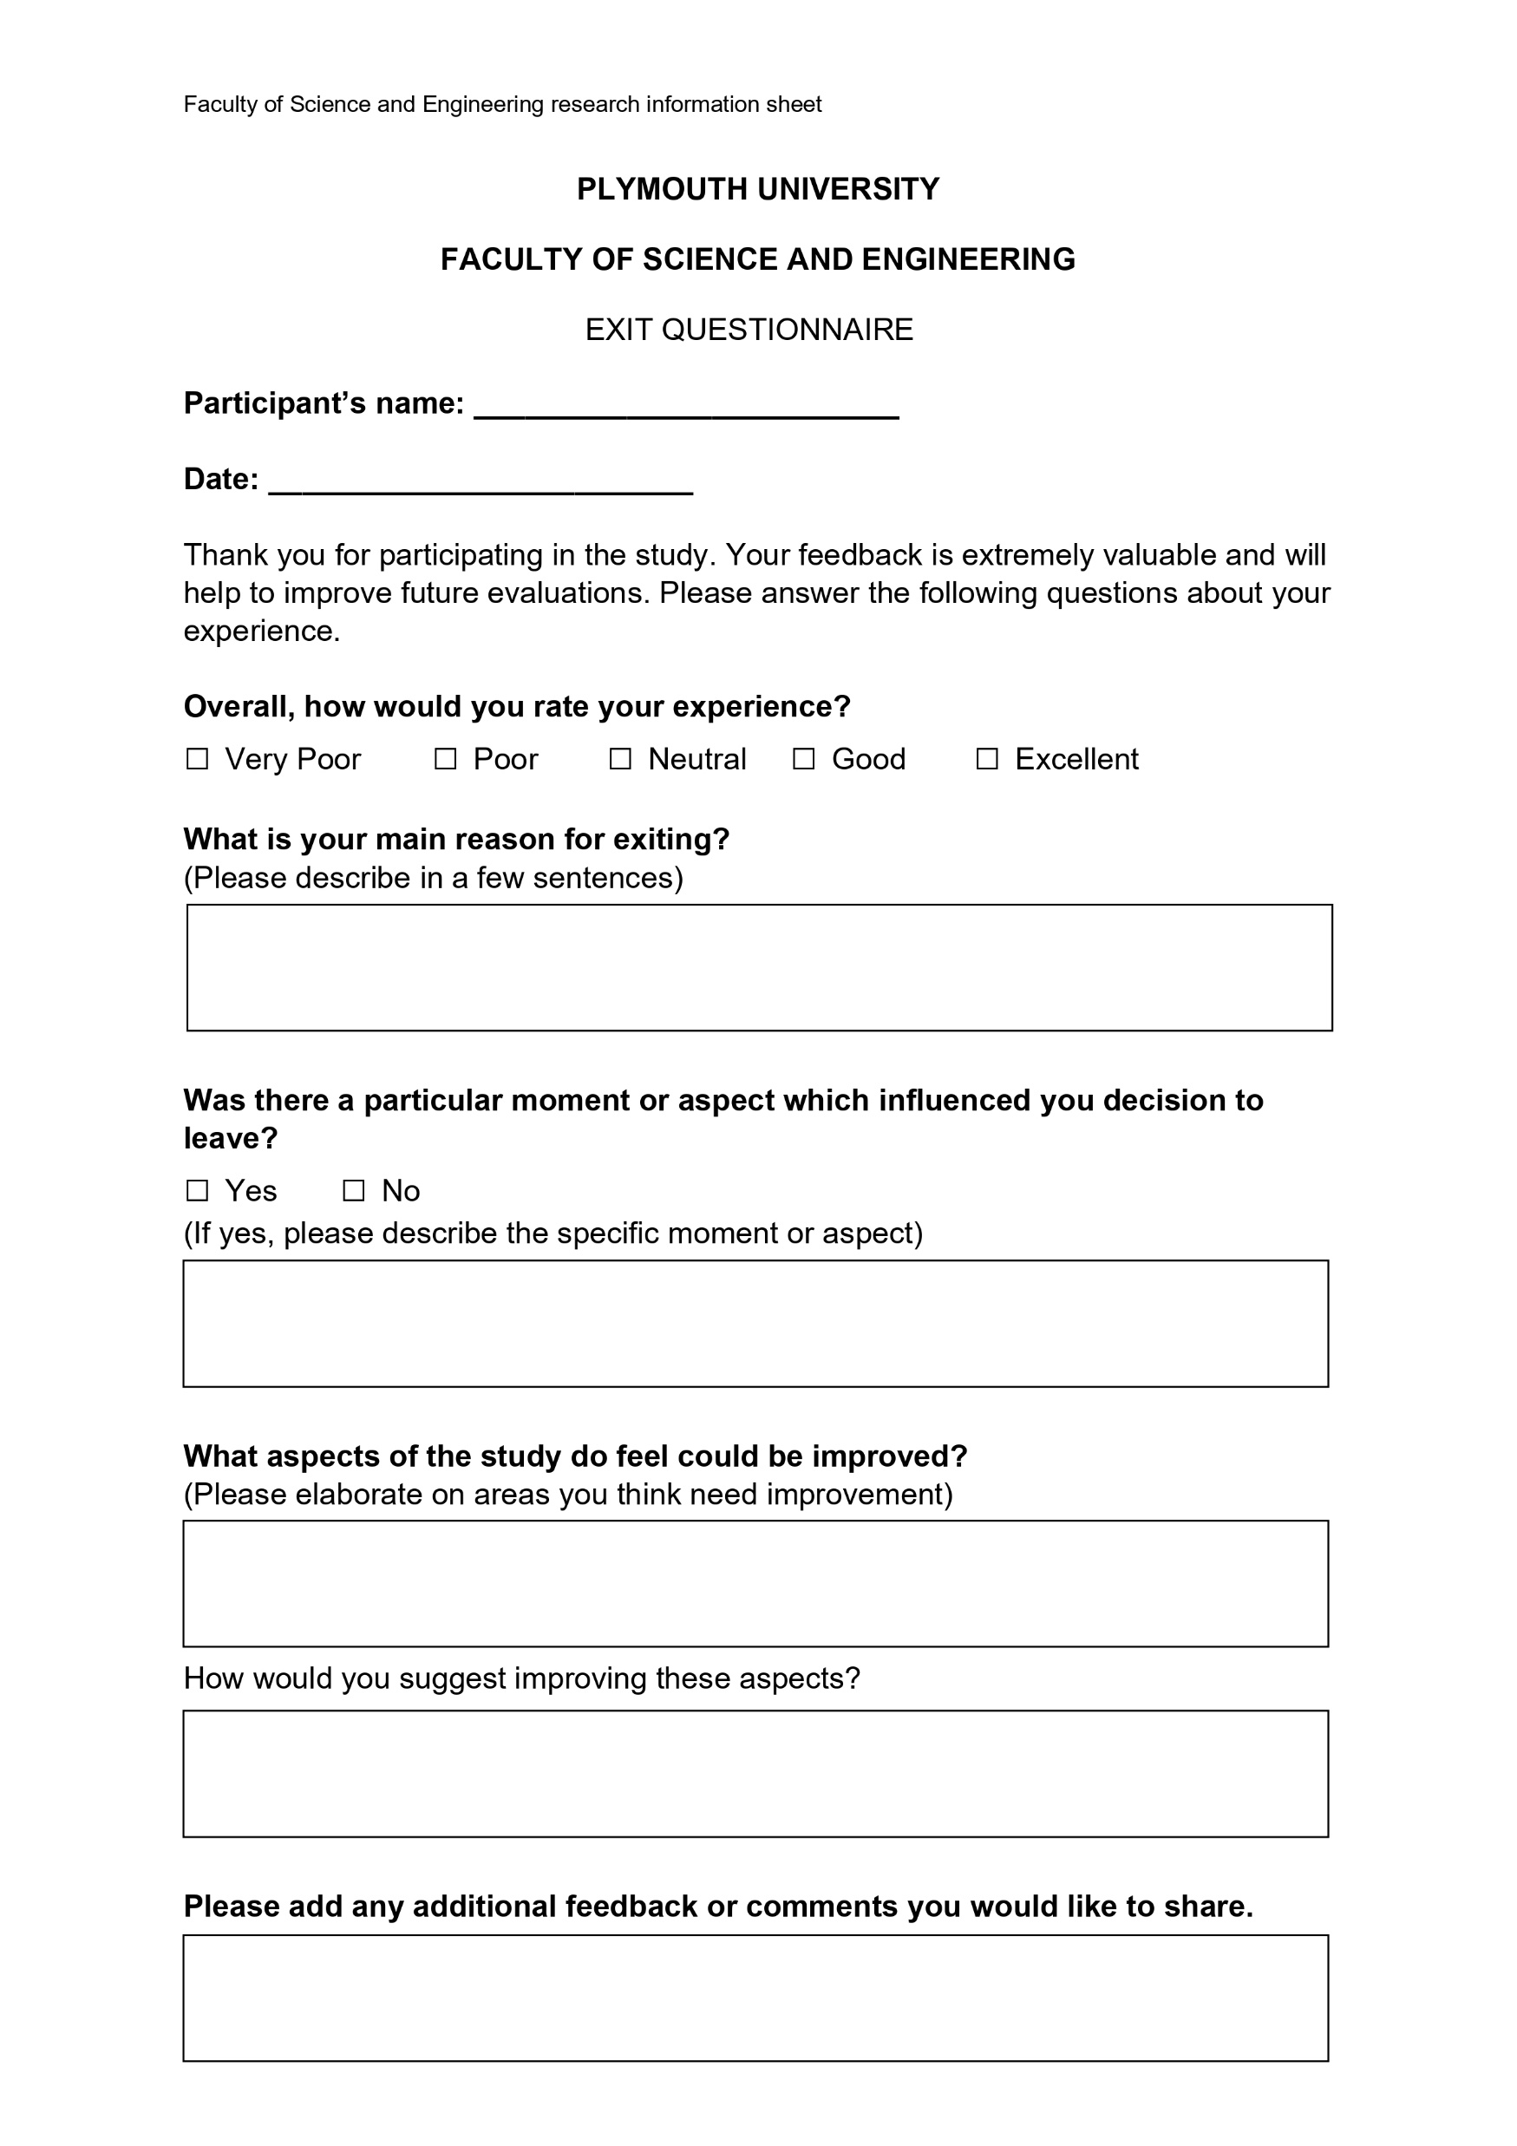
Documentation
University of Plymouth Ethics Approval
Research Information sheet
Right to Withdraw
Ethics Consent Form
Task Scenarios
Exit questionnaire

Slide 23
Section 2
Analysis and redesign process

Slide 24
Data Analysis - Quantitative
 | Mean | Median | Std Dev
Navigation Ease | 3.8 | 4 | 0.94
Page Titles Clarity | 4.3 | 5 | 0.86
Space Usage | 1.8 | 2 | 0.72
Contact Usefulness | 4.0 | 4 | 1.04
Book Now Button Clarity | 2.1 | 2 | 1.00
Menu Display | 4.6 | 5 | 0.88
Location Map | 4.4 | 5 | 0.88
Afternoon Tea Page Usefulness | 3.0 | 3 | 1.48
 | If Everyone Guessed | Accuracy
Page Identification | 14% | 45%
 | Prefer Top | Prefer Bottom
Info Bar Preference | 100% | 0%
Notes:
This is the quantitively data collected from the google forms survey.
The top table showing the mean and median averages along with the standard deviation of the results.
From this you can see that the space usage and book now page have low average scores and are problem points.
You can also see that the deviation in scores for the afternoon tea page usefulness is fairly high, meaning that opinions were mixed.
The 2nd table shows that the participants were somewhat able to identify the page they were on, but ideally the accuracy should be 100%.
The 3rd table shows that all of the participants preferred the info bar with the icons.

Slide 25
Data Analysis
Issues
Quotes
Space usage
Book now button clarity
Afternoon tea pages usefulness
Page identification
Design inconsistency
“I it see an email”
“get in touch & message us aren’t in line with each other”
“im unsure on this application its trying to make me open”
“it may appear to look suspicious and they may just click off”
“it doesn’t look like a booking section”
“shows a general area but not the specific area”
Notes:
The qualitative feedback echoed the quantitative data in some parts
And brought to attention more issues the users were dealing with.
The quotes from the feedback show some of the problems users were having with the website

Slide 26
Issues Identified
Essential
Desirable
Booking process clarity
Reduce navigation menu space
Page identification
Reduce excessive empty space
Justify afternoon tea pages existence
About us & contact page combination
Reduce menu image sizes
Info bar is inconsistency
Write email don’t link to open app
Start zoomed further into the map
Reduce Header image
Advertise vouchers
Advertise takeaway options
Rename mislabelled titles
Reorganise navigation menu
Notes:
From these results the identified issues were separated into two lists
The essential and desirable

Slide 27
Issues Identified
Essential
Desirable
Booking process clarity
Reduce excessive empty space
Page identification
Justify afternoon tea pages existence
Reduce menu image sizes
Reduce navigation menu space
About us & contact page combination
Rename mislabelled titles
Reduce Header image
Advertise vouchers
Advertise takeaway options
Reorganise navigation menu
Write email don’t link to open app
Start zoomed further into the map
Info bar is inconsistency
Notes:
These were then ordered by priority
with the most important at the top

Slide 28
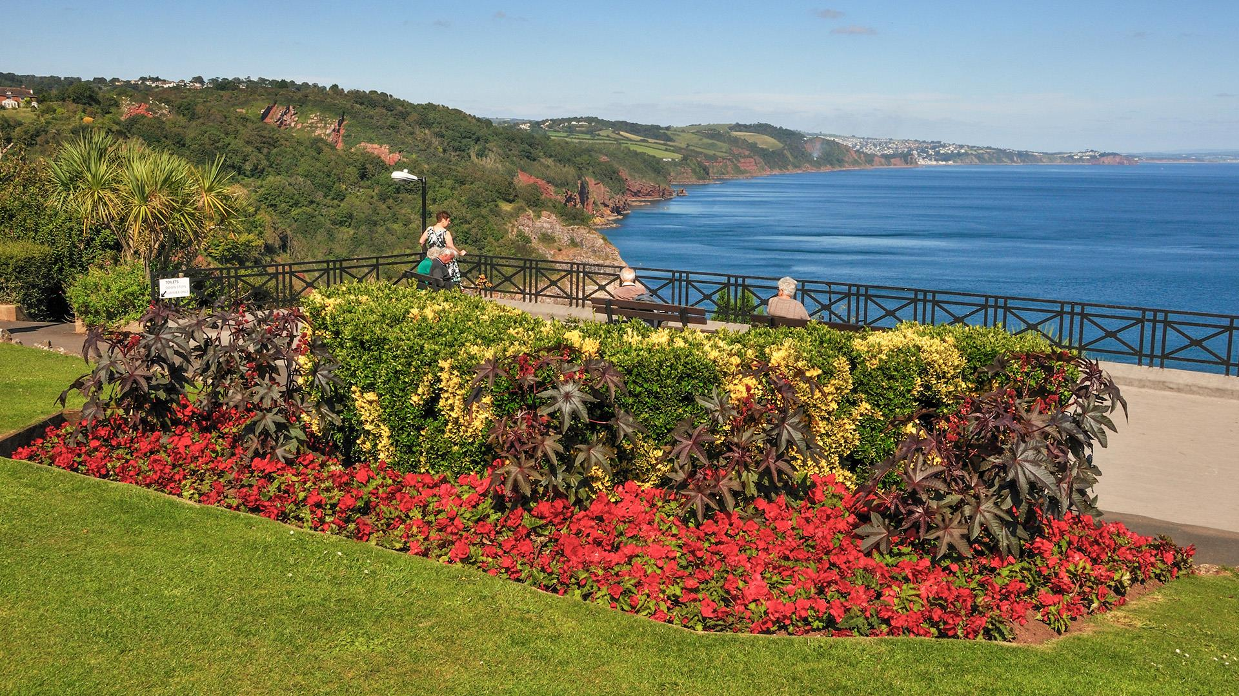
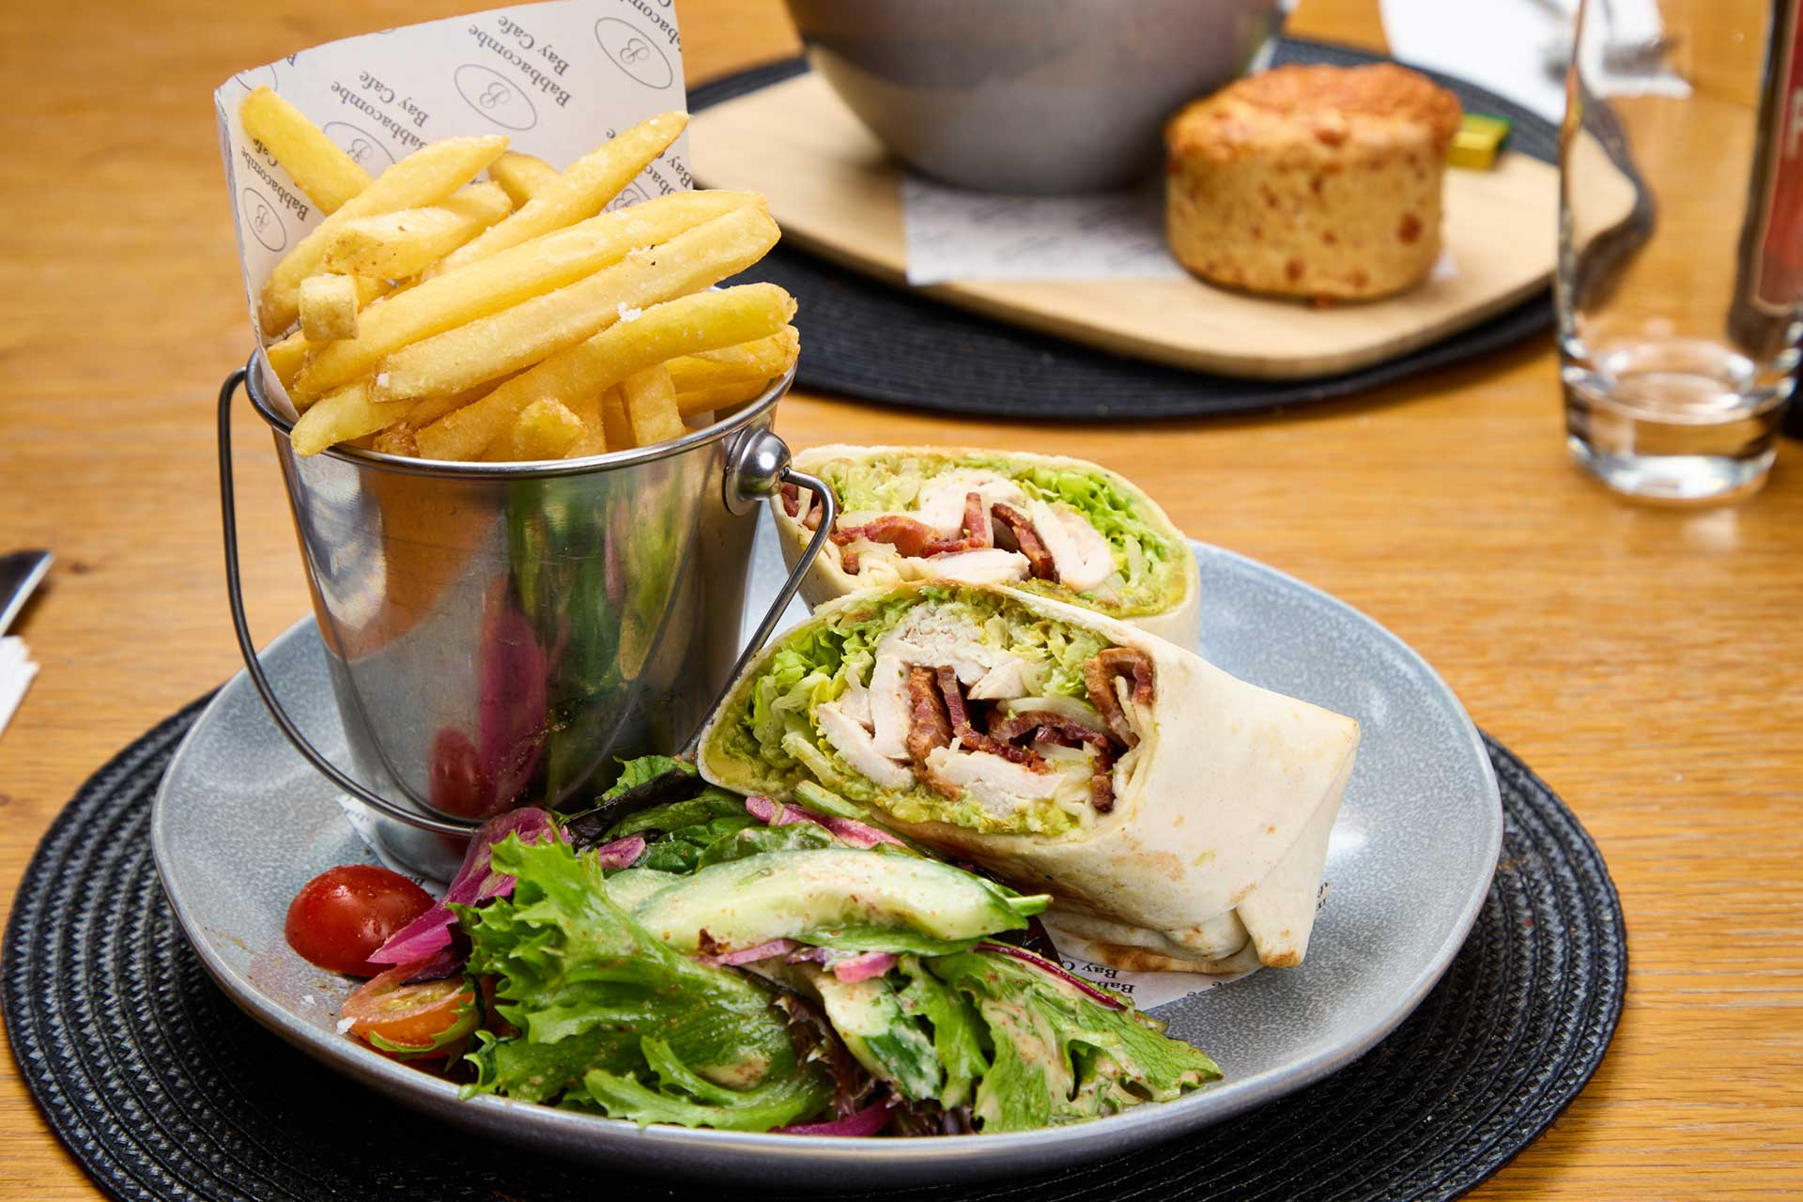
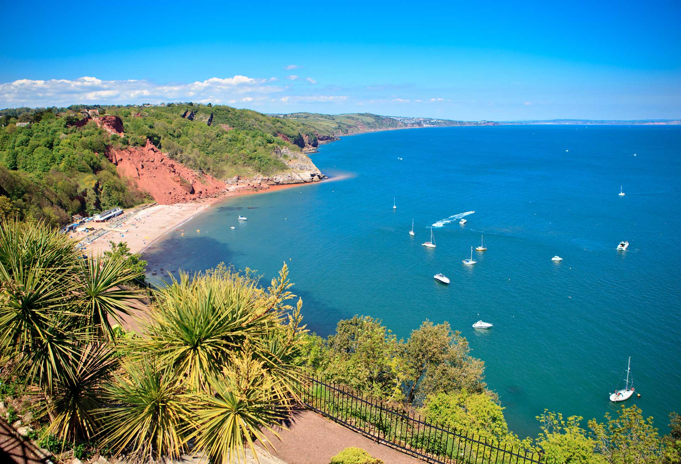
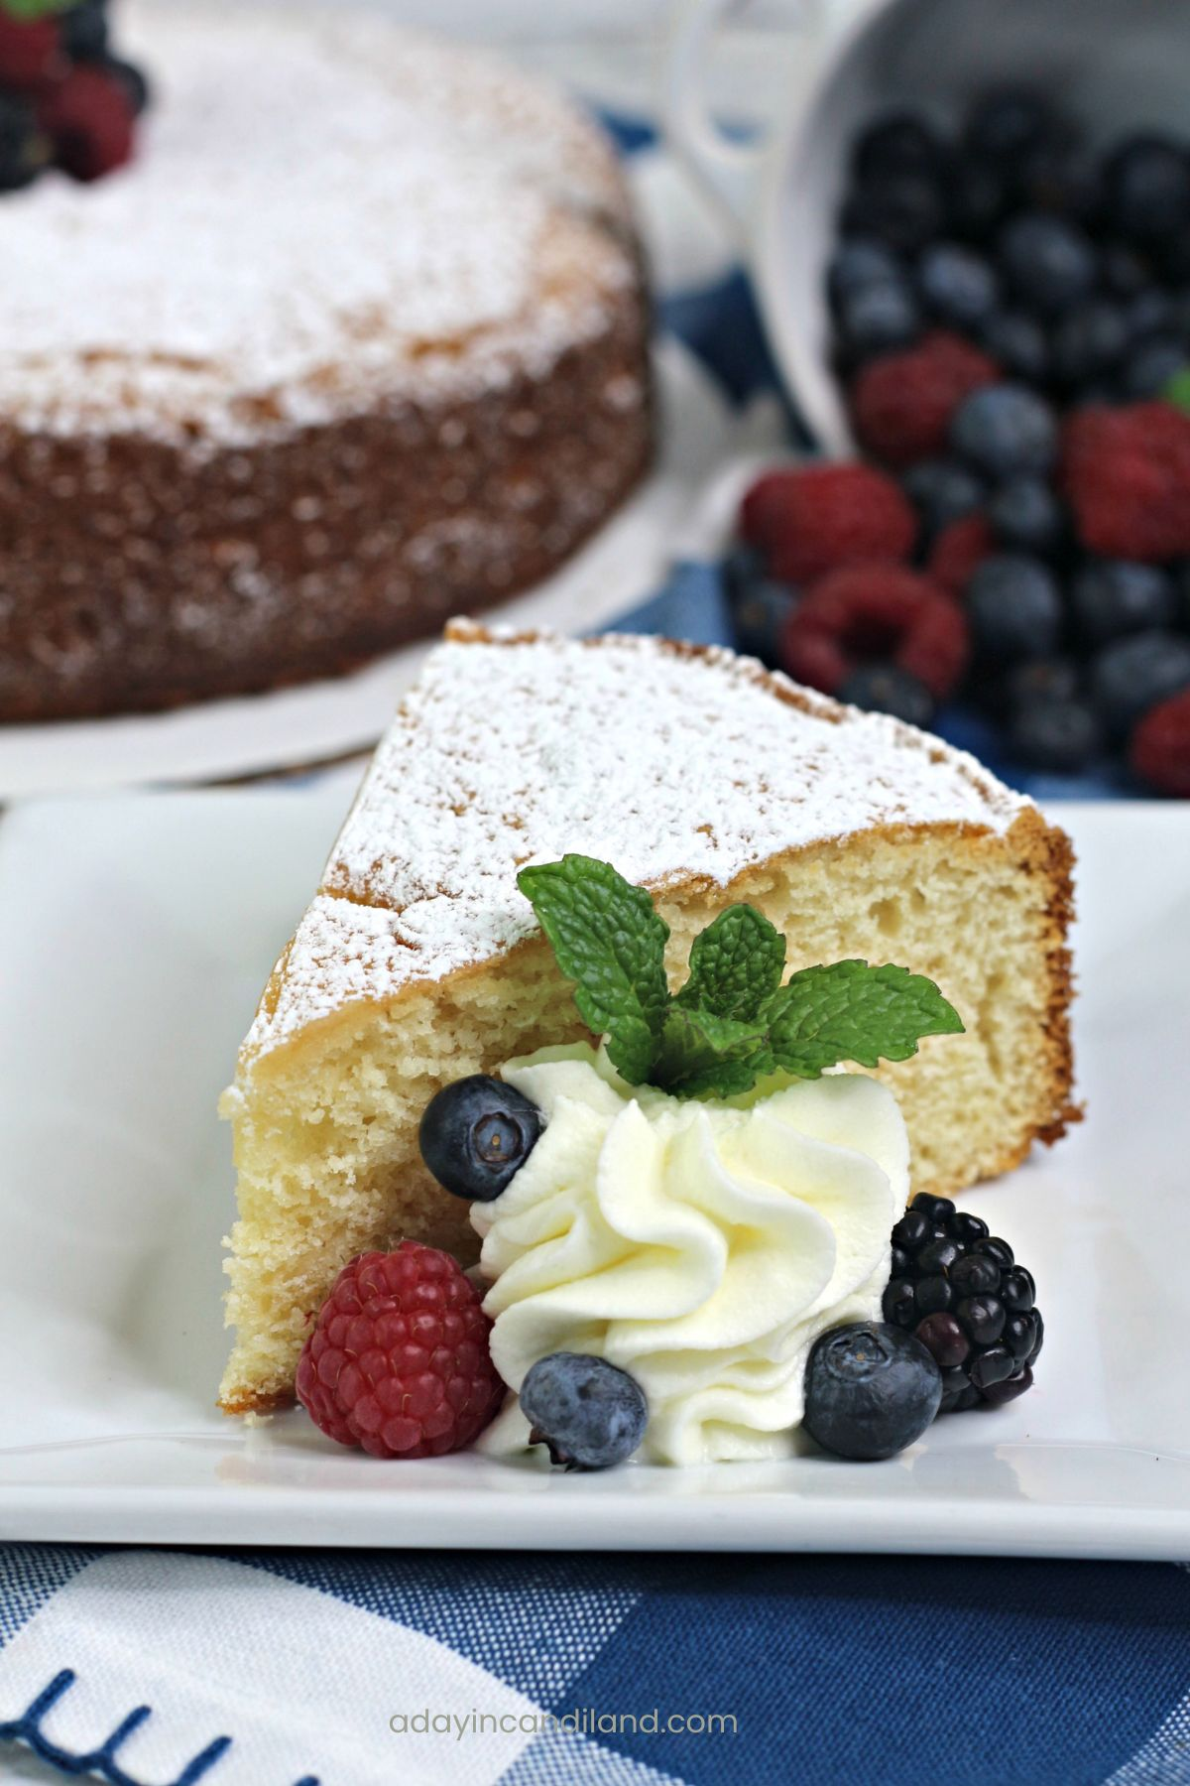
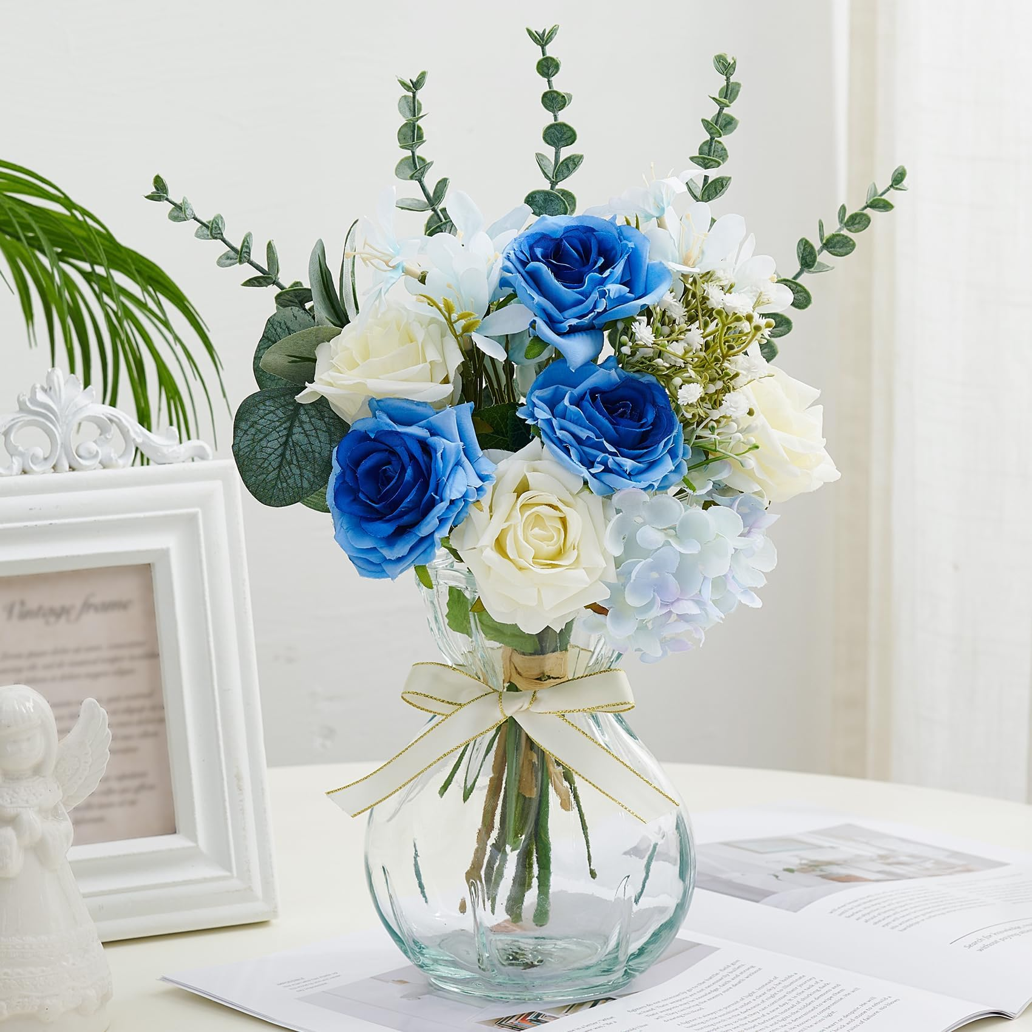
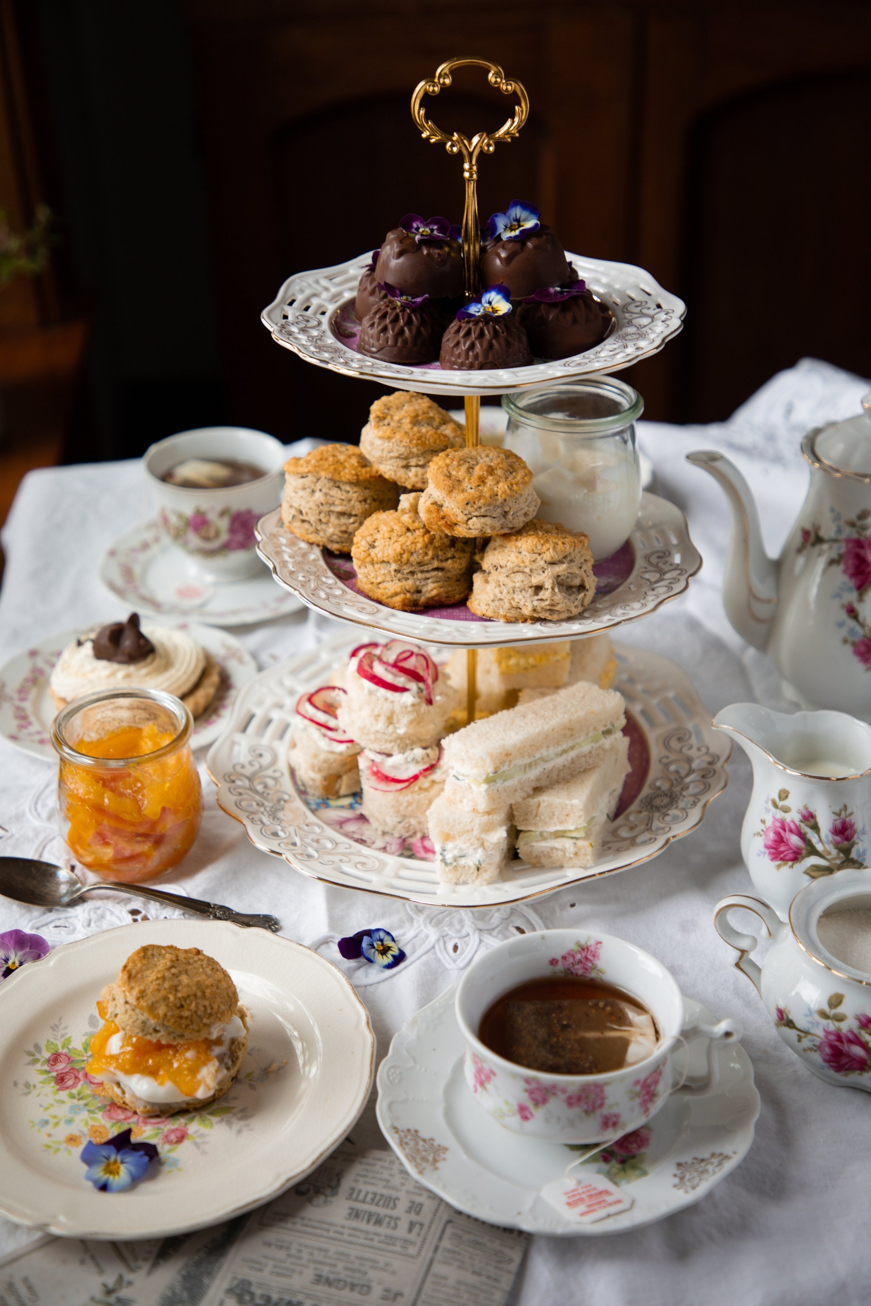
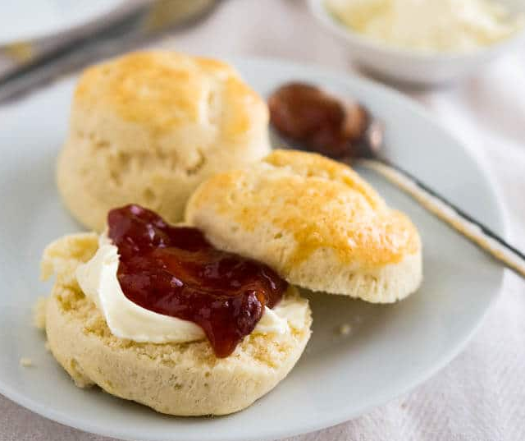

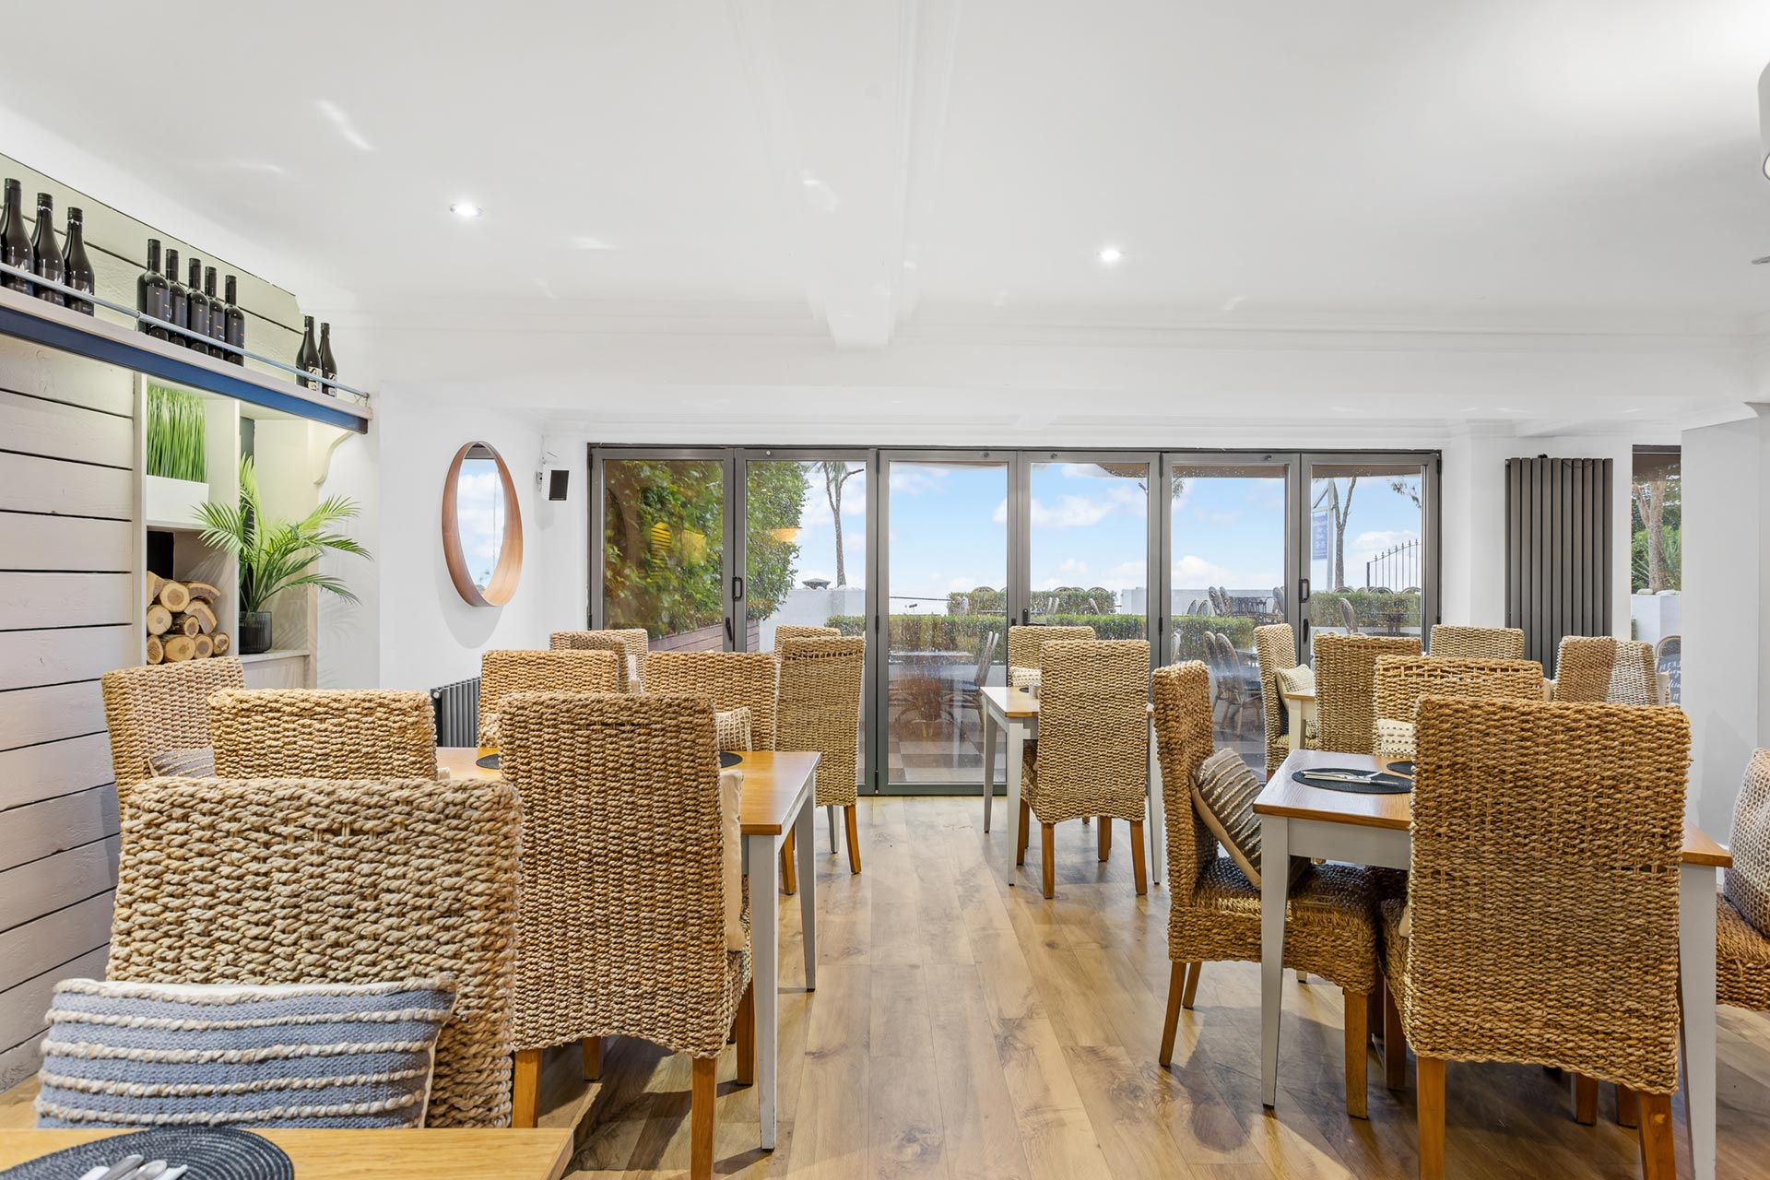
Mood Board
Notes:
The mood board reflects the cafés
With a clean modern design surrounded by natural seaside colours.

Slide 29
Section 3
Redesign ideas

